Slide 2
Optimal Territory Planning with Tableau
#data19

Slide 3


Slide 4





Territory Planning Software = Unitasker

Slide 5
Optimal Territory Planning with Tableau
Hunter Barcello
Data Scientist
Tableau
Justin Kruger
Sales Operations Manager
Tableau
#data19

Slide 6



Former professional moth trapper
Father of two
Runner & aspiring rock climber
Has a spreadsheet for everything
Notes:
Hunter
-Moth Trapper
-Two boys
-Relay Race & Climbing
-Spreadsheet for everything – when I asked my wife for facts about me to include in this – she said “Analyzes the **** out of everything” which is a sentence that could be a complaint, or an endorsement, depending on how you deliver it.

Slide 7





Off-Road Enthusiast
Fantasy basketball owner
Pitbull caretaker
Recently married
Notes:
Justin

Slide 8
Introductions
Notes:
Now let’s get to know you all a little bit better as well ☺
We’ll do a survey by show of hands
How many of you are in Sales?
What about Sales Operations specifically?
Analyst?
Management,
Other?
Now that we know a tiny bit about each other, could you turn to the person next to you and introduce yourself briefly. My hope is that today we’ll all get a chance to make a connection and learn from each other.

Slide 9
Session Agenda
Why Tableau?
General best practices
Choosing your metrics
Clustering geographic units
Demo
Notes:
Imagine cutting your teams’ territory creation time by over half, while using software you already have. By the end of the hour you’ll know how to do this with Tableau.
We’ll touch on some general best practices that we’ve learned while handling Tableau’s territory planning, because even the best tools can’t overcome bad communication or lack of alignment.
We’ll talk about how you determine which metrics you might want to look at to represent territory performance, we’ll provide a few ideas that we’ve used, and some ways to identify other options relevant for your business
Lastly, we’ll show you how we do it, using Prep & Desktop!

Slide 10
Why Tableau?

Slide 11
Why Tableau for Sales Territory Planning?
Value
Integration
Speed
Communication
Happier people ☺
Notes:
You could buy a specialized tool for territory planning, but why?
You already have Tableau!
Justin and I have worked with our dev team over the years using our specific territory planning uses cases to build features into the product to support this use case
We cut our territory creation time by 60-75% by switching to Tableau
Tableau will let your customers (Sales Team) interact with the data, you’ll be able to review and interact with the territories in real time, together. We’ve had some very valuable conversations walking sales leaders through dashboards interactively. In fact, we have some sales customers who will build their own territory scenarios to review, without having to go back to us for every change.
We’ve found the experience of making territories with Tableau is much more enjoyable than using other off the shelf solutions. Many were buggy, slow, and crashed often. We are also able to train new users more quickly, because they are already familiar with the Tableau interface.

Slide 12
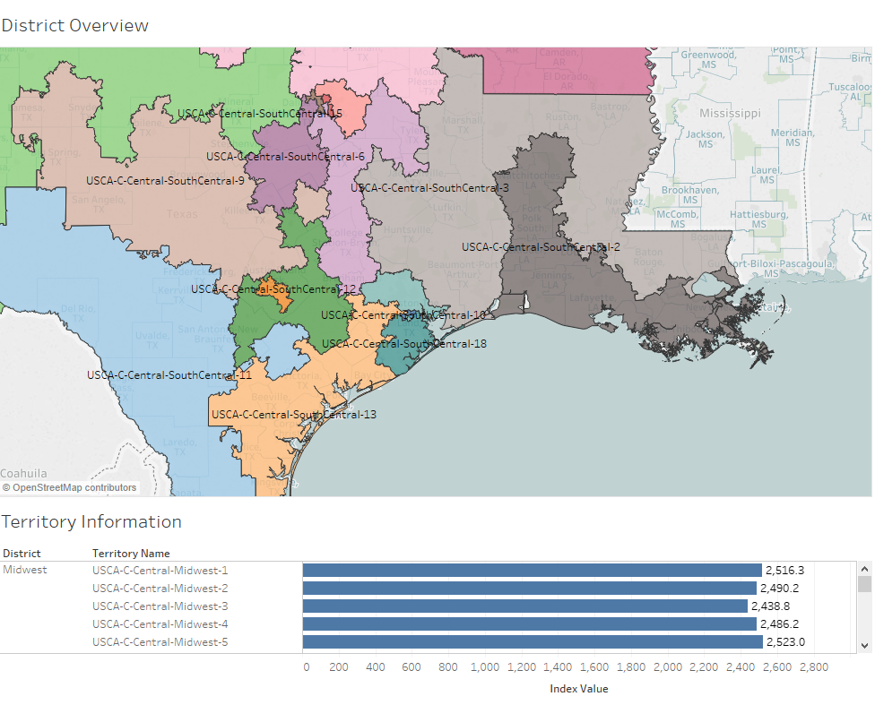
Why Tableau for Sales Territory Planning?
Notes:
By having this process in Tableau you'll be able to quickly transition to putting territory information in a useful and visually pleasing dashboard.

Slide 13
Best Practices
Notes:
…and now I’m going to hand off to Justin, who’s going to tell us about the keys to a successful territory rollout.

Slide 14
Keys to a successful territory rollout
Defined timeline
Engaged stakeholders
Clearly defined segmentation or rules of engagement
Headcount and growth plan
Clear definition of a customer and key metrics
Notes:
Timeline – self explanatory
Engaged Stakeholders – This is a partnership between your Sales Ops/Territory team and Sales/Business. If Sales isn’t able to give feedback or engaged you’ll be facing an uphill battle.
Good news is that we’ve had really good engagement using Tableau as a tool to help visualize and understand the sales territories.
In order to accurately portray and balance territories, we need to have a clear understanding of where accounts are going to land for the next year. If we can’t count on that, no way to be sure of balance.
While we don’t have to be 100% locked in for headcount, there needs to be a solid understanding of how these segments will be staffed. If we are planning on 5 sales reps one week, then 15 the next, that will be hard to everyone involved.
This last one is a tough one for a lot of organizations. What do we mean by a customer? Is it an account in SalesForce, is it a Corporate entity, do they have to have bought with us to be considered a true ‘customer’? Similar with metrics, how do we define sales? Are renewals included if you are in a subscription business, what is a transaction, are all sales on one day a transaction, each item, or each purchase order?

Slide 15
End-to-End Sales Planning Process
Go To Market (1-3) Duration ~ 2 Months
Territory & Quota Creation (4-6)
Duration ~2 Months
Compensation Plan Distribution (7-8) Duration ~1 Month
Revenue Target by Geography
Issue Plan Documents
Segmentation
Quota to Sellers
Resource Model
Sellers to Territory
Territory Construction
Quota Distribution
Notes:
Approach that we take is initial tops down then blend into a bottoms up approach
Go To Market (Tops down and research):
1. Revenue Targets by Geography (Identify major markets across the globe in which are your sales organization
2. Segmentation: Rules to ensure consistency as it relates to process, people and technology. Which accounts in which segments (commercial, enterprise, vertical markets, etc.)
3. Resource Model: # of Headcount by role
Territory & Quota Creation (Transition of GTM tops down into the bottoms up)
*** 4. Territory Construction: Think of these as the chairs in which direct sellers will sit into with a group of accounts (customers & prospects) ***
5. Quota Distribution: based upon the accounts (custom quotas) or role (role based quotas)
6. Sellers to Territories: Assigning the sellers into the seats that were created in step #4
Compensation Plan Distribution
7. Quota to Sellers: Formalization to
8. Issue Plan Document:

Slide 16
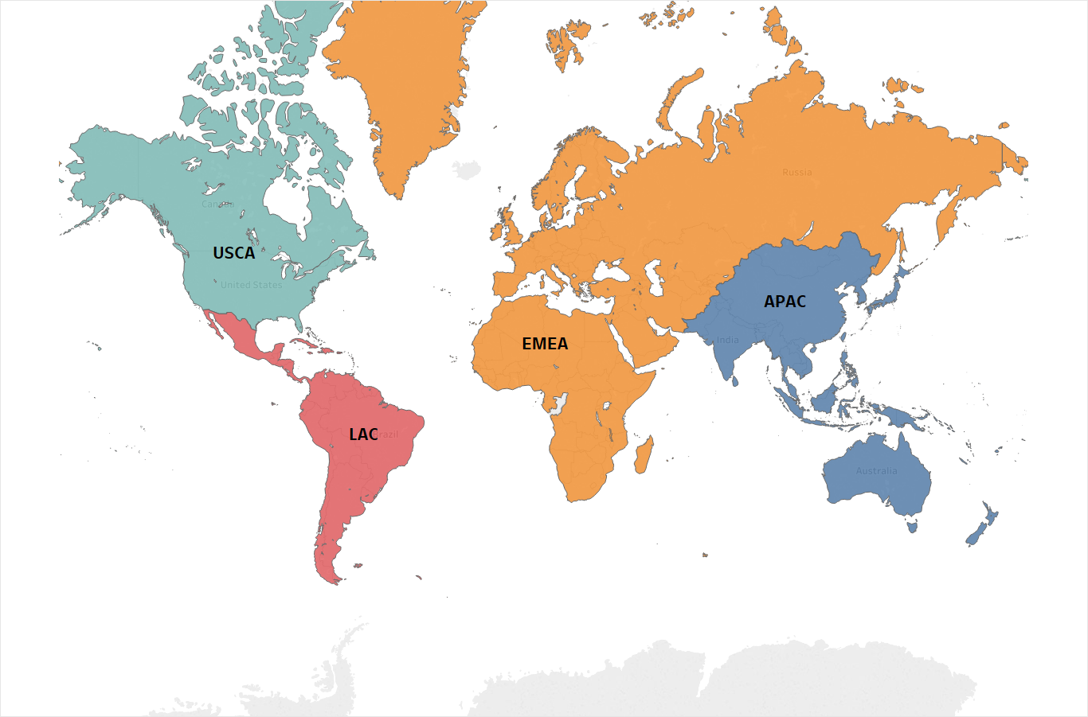
Revenue Targets by Geography
Tableau $193 Million
EMEA $50 Million
United Kingdom $20 Million
DACH $30 Million
USCA $110 Million
East $90 Million
Global
Region
Sub-Region
APAC $23 Million
Japan $13 Million
India $10 Million
West $20 Million
Revenue Target by Geography
Issue Plan Documents
Segmentation
Quota to Sellers
Resource Model
Sellers to Territory
Territory Construction
Quota Distribution
Notes:
1. Revenue Targets by Geography (Identify major markets across the globe in which are your sales organization
Here is where the head of sales and departments (sales, product, etc.) work with the theater leaders indevelopment of where investments are going to be made as it relates to sales organization for market growth.
These targets are top-down high level guidance to enable theater leadership to work with their direct reports downwards in as the transistion to a bottoms up plan begins to unfold.
Questions:
> Are there markets in which we want to grow faster?
> Markets that we feel are saturated? Etc.
> Product limitation results in change when selling into countries
> Company establishment within markets across the departments

Slide 17
Segmentation
Geography
Postal Code or Country
Localization across customers and prospects
Vertical Markets
Customers require specific use cases
Sellers with expertise
Large opportunity for expansion overtime
Line of business size
Enterprise vs. commercial
Duration of sales cycle
Deployment considerations
Revenue Target by Geography
Issue Plan Documents
Segmentation
Quota to Sellers
Resource Model
Sellers to Territory
Territory Construction
Quota Distribution
Notes:
2. Segmentation: Rules to ensure consistency as it relates to process, people and technology. Which accounts in which segments (commercial, enterprise, vertical markets, etc.)

Slide 18
Resource Model (Blueprint)
Strategic Field Sellers
Named Field Sellers
Selective List of Accounts
Small List of Accounts
Mid-Market Inside Sellers
Geographic Based
Small Medium Business Sellers
Geographic Based
Revenue Target by Geography
Issue Plan Documents
Segmentation
Quota to Sellers
Resource Model
Sellers to Territory
Territory Construction
Quota Distribution
Notes:
3. Resource Model: # of Headcount by role

Slide 19
Territory Construction
Revenue Target by Geography
Issue Plan Documents
Segmentation
Quota to Sellers
Resource Model
Sellers to Territory
Territory Construction
Quota Distribution
Notes:
*** 4. Territory Construction: Think of these as the chairs in which direct sellers will sit into with a group of accounts (customers & prospects) ***
Geographic Based:
> To scale, create "puzzle pieces" in which is a ratio of territories to sellers. Enables easier movement for attrition and hiring.
> When provided different roles (aka quotas) on the same team, have a mechnism to account for the increase in a quota
Account Based:
> have a Total Addressable Target (TAM) methodology in place as recommendation engine
>

Slide 20
Quota Distribution
Revenue Target by Geography
Issue Plan Documents
Segmentation
Title | Model | USCA | APAC | EMEA
Commercial TM | Commercial | $750K | $600K | $700K
Senior Commercial TM | Commercial | $900K | $750K | $800K
Commercial AM | Commercial | ~$1M | ~$800K | ~$900K
Senior Commercial AM | Commercial | ~$1.1M
Account Executive | Enterprise | ~$2M | ~$1M | ~$1.5M
Strategic Account Executive | Enterprise | ~$3M | ~$2M | ~$2.5M
Quota to Sellers
Resource Model
Sellers to Territory
Territory Construction
Quota Distribution
Notes:
5.Quota Distribution
Magic of true tops down targets to territory construction for bottoms up plan. Key here is combining steps 1 – 4 as it relates to fair and equitable for all sellers, direct managers, and above to be bought into their territory and quota being assigned once the new year starts.

Slide 21
Sellers to Territory
Revenue Target by Geography
Territory Name | Direct Seller | Customer Success | Manager
APAC-JAPAN-1 | Ainu Sato | Agnes Tanaka | Riku Fujimoto
USCA-EAST-2 | Sue Miller | Brad Walters | Frank Coors
EMEA-UK-1 | Jacob Clarke | Colleen Switz | Charlie
Issue Plan Documents
Segmentation
Quota to Sellers
Resource Model
Sellers to Territory
Territory Construction
Quota Distribution
Notes:
6. Sellers to Territories: Assigning the sellers into the seats that were created in step #4

Slide 22
Metric Selection

Slide 23
Identifying key metrics for optimization
What are your key, measurable, business drivers or KPIs?
Examples:
Number of customers
Transactions
Customer spend
New customers
Product adoption/saturation
Subscription renewal rate
Lead flow
Notes:
This could depend on your business unit or segment. If you are in more of a business development unit, you might be more focused on new customers and transactions. More of an Enterprise existing business, you are going to care more about customer spend, maybe their renewals business too. Businesses where you have a broad product offering you might also want to look at their adoption of your product suite.

Slide 24
Identifying key metrics
Extra Credit : Understand how these metrics affect future sales
Goal : Develop at least one training data set to help guide your selection and weighting process
Target
Customers as of 10-1-2018 | Sales 10-1-2016 to 10-1-2018 | Leads 10-1-2016 to 10-1-2018 | Sales 10-1-2018 to 10-1-2019
23 | $ 17,482.00 | 35 | $ 12,158.00
29 | $ 14,082.00 | 43 | $ 18,648.00
5 | $ 3,041.00 | 7 | $ 2,779.00
1 | $ 4,698.00 | 1 | $ 384.00
3 | $ 18,759.00 | 6 | $ 5,868.00
2 | $ 8,121.00 | 34 | $ 3,587.00
Notes:
Not everyone will have this data available or be able to reconstruct it, but if you can, you definitely should!
The exact data you choose to analyze could depend on your business unit or segment. If you are in more of a business development unit, you might be more focused on new customers and transactions. More of an Enterprise existing business, you are going to care more about customer spend, maybe their renewals business too. Businesses where you have a broad product offering you might also want to look at their adoption of your product suite.

Slide 25
Clustering Geographies

Slide 26
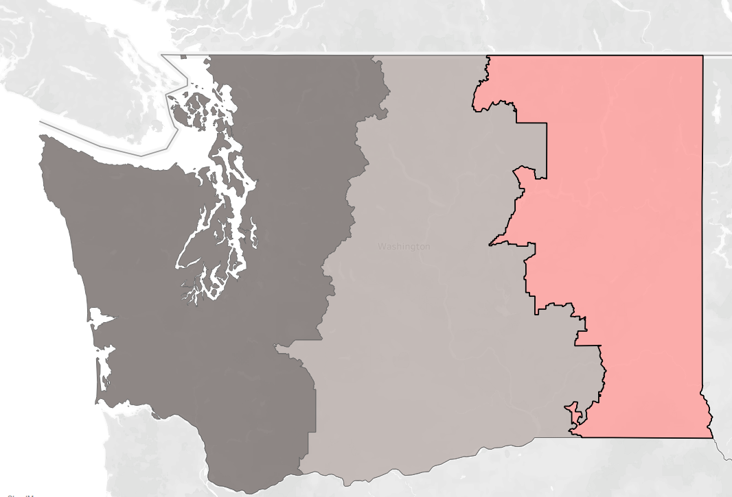
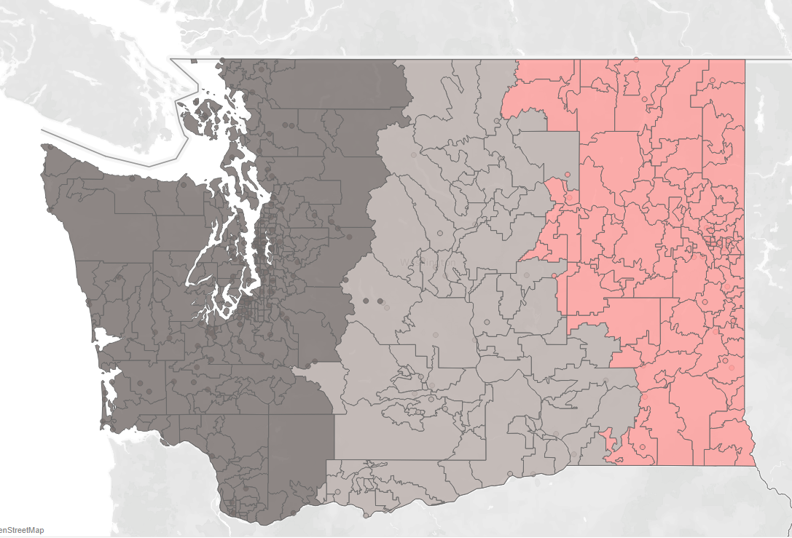
Why Clustering?
Reduce 40k+ Postal codes to < 1000 clusters
Flexible cluster creation
Customers are often clustered together
Algorithmically fast
or…

Slide 27
Example Use Case

Slide 28
Business Scenario
Office Supply “Super Store”
We need to plan territories for 3 account managers in 2019
We built a simple linear model and found that these factors contribute to future office supply sales
Lifetime transactions (30%)
Number of customers (30%)
Spend in the last 2 years (40%)
Notes:
FEEDBACK: Slim down the slide

Slide 29
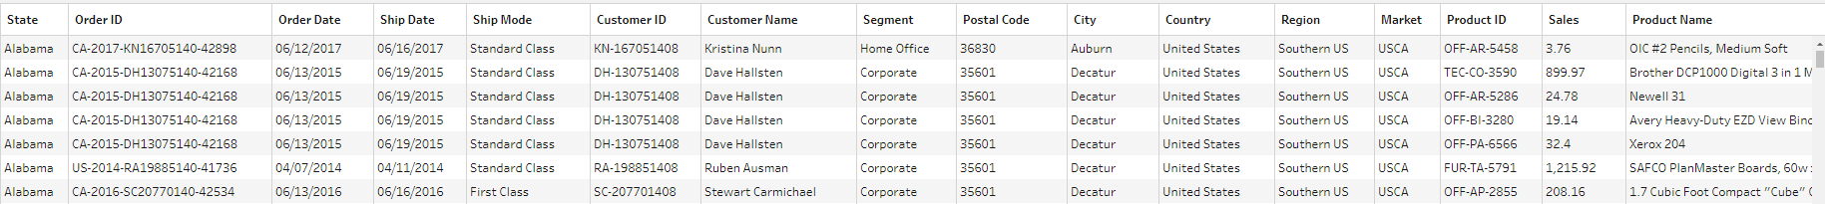
Business Scenario
We have our sales information at the transaction level. We will aggregate to the smallest unit we assign (State, Postal Code, etc)
We will be aggregating to the postal code level in our business scenario. We want to map out ownership of each individual postal code.
Notes:
Edit slides down to only imagines/visualisation.. Content will be verbal

Slide 30
Readying metrics for territory creation
Eliminate outliers (optional) and scale measures
Scaling measures lets us easily compare two different types of numeric data such as number of employees and dollars of spend.
Without Scaling…
2,000 Employees + $100,000 Sales = ???

Slide 31
Readying metrics for territory creation
Scaling preserves the linear relationship, and lets us compare across measures more easily
Once data is aggregated appropriately…
Divide by the maximum observed value, multiply by 1000 (or 100, whatever you like)
Previous example continued:
2000 Employees + $100,000 Sales = ???
Data set maximum is 10,000 employees, $1,000,000 in sales
(2,000/10,000)*1000 = 200 Employee Index
(100,000/1,000,000)*1000 = 100 Sales Index
200 + 100 = 300 Index
Notes:
Really dig into slowing down to ensure foundation requirements
How are these indexes related?
Index = practice to create one source of measurement

Slide 32
Demo

Slide 33
Start RServe
Notes:
We are spending less money, creating territories faster, and having much better customer experience and dialog since switching to Tableau
Before we start creating territories we need to make sure that everyone is in agreement on metrics, definitions, timeline and headcount
Larger teams can be challenging, but clustering appropriately lets us continue to be nimble and balanced in our territory creation
Being able to create custom territories with Tableau – game changer

Slide 34
Prep Workflow

Slide 35
Shutdown RServe

Slide 36
Create Territories In Tableau

Slide 38
Takeaways
Build territories faster, cheaper and better with Tableau
Ensure your group is aligned and engaged before beginning territory creation
Once a segment is large enough that States and Provinces need to be split up, optimization can get challenging. Clustering algorithms solve this problem
Key feature is using custom Geography from a field. Use the cluster ID, generating geography from postal code
Notes:
We are spending less money, creating territories faster, and having much better customer experience and dialog since switching to Tableau
Before we start creating territories we need to make sure that everyone is in agreement on metrics, definitions, timeline and headcount
Larger teams can be challenging, but clustering appropriately lets us continue to be nimble and balanced in our territory creation
Being able to create custom territories with Tableau – game changer

Slide 39
Informational Links
Git Repo : Clustering script and data from this demo are all located here
https://github.com/hbarcello/TC19_TableauSalesOps
R Studio : Open source ML
https://www.rstudio.com/products/rstudio/download/

Slide 40
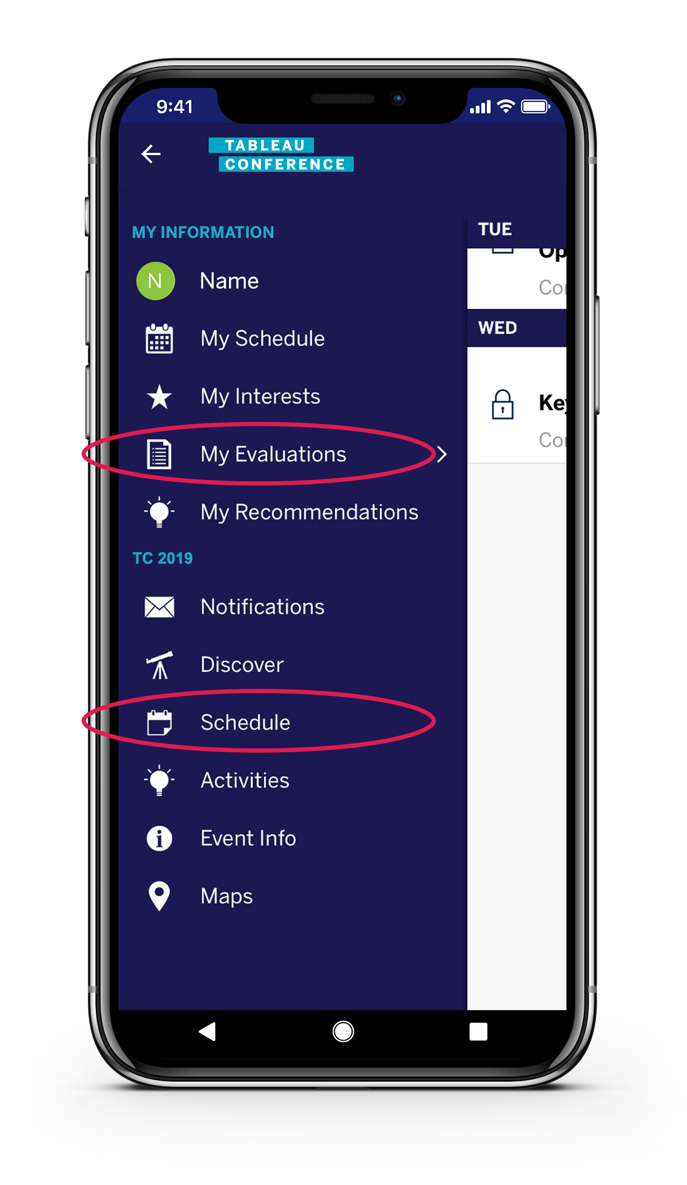
View ‘My Evaluations’ in the menu or find your session under ‘Schedule’
Please complete the session survey in the mobile app

Slide 41
Q & A

Slide 42
Thank You
Hunter
hbarcello@tableau.com
Justin
jkruger@tableau.com

